Slide 1

GENERATIVE AI | MACHINE LEARNING | ADVANCED ANALYTICS | DATA ENGINEERING

Slide 2

1
Business Objective
2
HR Recruitment
Agenda
3
Learning & Development
4
Previous Experience
5
Delivery Model

Slide 3
1
Business Objective
2
HR Recruitment
Agenda
3
Learning & Development
4
Previous Experience
5
Delivery Model

Slide 4
Business Objective
Help improve the effectiveness of HR processes using Gen AI capabilities
1
2
3
4
Hiring
Retaining
Up-skilling
Retiring
Automate resume screening
Scheduling interviews
Automate tests
Personalized communication
Bias reduction
Create employee recognition programs
Virtual assistants
Innovation and mentorship programs
Collaboration tools
Personalized training programs
Inclusion programs
Educational resources
Knowledge capture
Personalized retirement plans
Retirement workshops
Document preparation
Health assessments

Slide 5
1
Business Objective
2
HR Recruitment
Agenda
3
Learning & Development
4
Previous Experience
5
Delivery Model

Slide 6





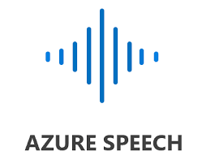


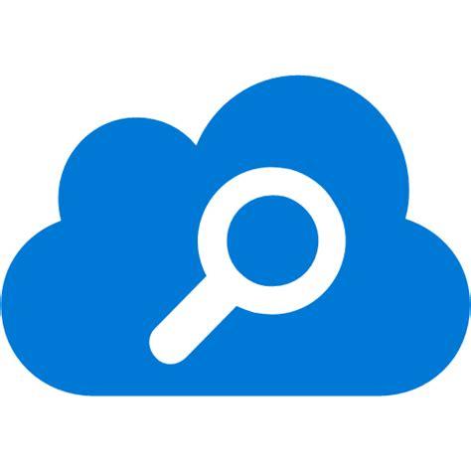
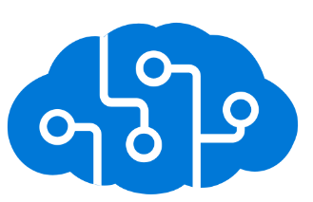



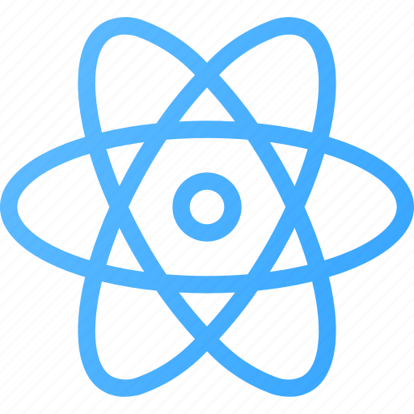

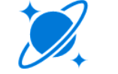
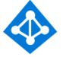

Azure Gen-AI Infrastructure for PDF/Text Processing
6
Azure Virtual Network
AZURE VM
NESGEN SANDBOX
Documents
A
Open AI GPT 3.5 and 4
Open AI GPT 4 Turbo 1106
Open AI GPT 4 Vision
Open AI text-embedding-3-small/large/ada-002
Open AI Whisper
Open AI Dalle
Audios
AI Document Intelligence
Nestle MIDAS
i
B
AI Speech Service
C
Blob Storage
AI Services
4
Prepare
2
3
5
ASL/ Partner Team
NesGen Accelerator Sandbox
SQL Database
Cognitive Search
Query
1
7
9
Business
User
Response
App Service
Transorg’s AI Firewall
Chatbot UI
8
6
Entra ID
Azure Monitor
Cosmos DB

Slide 7
Azure Gen-AI Infrastructure for PDF/Text Processing
7
Azure Virtual Network
AZURE VM
ChatPG SANDBOX
Documents
A
Audios
AI Document Intelligence
P&G Data
i
B
AI Speech Service
C
Blob Storage
AI Services
ChatPG
SQL Database
Cosmos DB
Entra ID
Azure Monitor

Slide 8








Azure Gen-AI Infrastructure for Text/Audio Processing
Azure Virtual Network
For Network security and Data Privacy.
Ensures applications and data are protected in a private, secure environment.
Transorg’s AI Firewall
Act as a Guardrails for safe and relevant inputs as well as outputs
A-C: Data Management
Data ingestion and preprocessing with Azure AI services
1-2: User Interaction
User query processed by AI firewall
Display query in React chatbot UI, connect to SQL database
3-5: Query Handling
Forward query to Azure Cognitive Search
Retrieve document/audio representations
Send query to OpenAI Service
6-9: Response and Logging
Get response from OpenAI model
Log query-response in Cosmos DB and SQL
Display response via chatbot UI
i: Scheduled Backup
Schedule regular backups from Azure SQL to MIDAS to reduce Azure storage costs

Slide 9
1
Business Objective
2
HR Recruitment
Agenda
3
Learning & Development
4
Previous Experience
5
Delivery Model

Slide 10




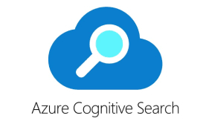




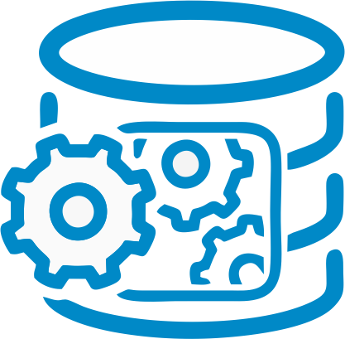















Learning & Development Process Flow
Employee Data
Azure Open AI
Employee Assessment Data
Transorg’s AI Firewall
Training Recommendation
Backend Server
Training Repository
Data Integration and Preprocessing
Training roadmap
Data Input
Customised
Time period
Employee
Bandwidth
Personalized
Roadmap
AI Analysis
Monitoring and Feedback
Training Review and approval
Notification,
Implementation, Assessment

Slide 11

Azure Gen-AI Infrastructure for Structured Data
11
Azure Virtual Network
AZURE VM
NESGEN SANDBOX
Open AI GPT 3.5 and 4
Open AI GPT 4 Turbo 1106
Open AI GPT 4 Vision
Open AI text-embedding-3-small/large/ada-002
Nestle MIDAS
A
i
5
4
Query
Verification
Prepare
2
3
ASL/ Partner Team
6
NesGen Accelerator Sandbox
SQL Database
Query
1
8
10
Business
User
Response
App Service
Transorg’s AI Firewall
Chatbot UI
9
7
Entra ID
Azure Monitor
Cosmos DB

Slide 12
Nestle Gen-AI Infrastructure for Structured Data
Azure Virtual Network
For Network security and Data Privacy.
Ensures applications and data are protected in a private, secure environment.
Transorg’s AI Firewall
Act as a Guardrails for safe and relevant inputs as well as outputs
A-C: Data Management
Data ingestion and preprocessing with Azure AI services
1-2: User Interaction
User query processed by AI firewall
Display query in React chatbot UI, connect to SQL database
3-6: Query Handling
Natural Language-SQL Conversion
SQL Command Verification / Agentic Workflow
Run command on SQL Database
Send SQL data and query to Open AI Service
7-10: Response and Logging
Get response from OpenAI model
Log query-response in Cosmos DB and SQL
Display response via chatbot UI
i: Scheduled Backup
Schedule regular backups from Azure SQL to MIDAS to reduce Azure storage costs

Slide 13
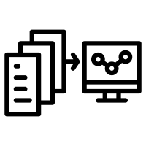

Why are we different?
13
Interaction Logging
Agentic Query Screening
Transorg’s AI Firewall
Authentication & Customization: Ensures authorized access with role-based controls and allows customization of firewall rules for organizational needs
Guardrail Enforcement: Blocks inappropriate content and analyzes query context to ensure safe, ethical use, preventing misleading or malicious inputs.
Interaction History: Provides a detailed trail of user interactions, allowing comprehensive analysis of system performance, user behavior, and response quality.
Data-informed Improvement: By analyzing these logged interactions, valuable insights into user needs and preferences can be gained, guiding strategic decisions and prioritizing enhancements based on real-world usage data.
Semantic and Syntactic Validation: The agentic query verification workflow ensures that the generated queries are syntactically correct and semantically relevant to the user's intent.
Security, Data Integrity and Compliance: Identifies and prevents unauthorized or harmful queries, protecting sensitive data and ensuring adherence to Data Governance policies.

Slide 14
1
Business Objective
2
HR Recruitment
Agenda
3
Learning & Development
4
Previous Experience
5
Delivery Model

Slide 15
Gen AI use cases at Transorg
CX – LLM (Customer Experience with LLM)
Aviation
Implementation: Integrated a GPT-powered chatbot into a leading airline's reservation platform.
Function: Employs GPT to facilitate seamless communication and booking assistance.
Impact: Optimized user experience by smoothing and clarifying interactions during booking.
LLM Driven HR Query Management Chatbot
Aviation
Innovation: Pioneered a cutting-edge HR Query Management Bot powered by an advanced RAG framework.
Functionality: Seamlessly taps into the client's knowledge base to streamline routine tasks for users.
Outcome: Achieved remarkable decline in service requests, enhancing accessibility and operational efficiency significantly.
Knowledge Management Chatbot
Hospitality and others
Solution: Engineered a user-friendly chatbot integrated with Customer Data Portal to glean business insights from diverse datasets effortlessly.
Purpose: Facilitates seamless value extraction from intricate datasets, eliminating the need for SQL expertise.
Result: Empowered a wider user spectrum with enhanced data accessibility & fostering informed decision-making.
GenAI Call Assistance Bot
Insurance
Development: Advanced GenAI driven call bot integrated with Customer Data Portal for enriched insights.
Function: Provides instantaneous recommendations to enhance sales interactions and support customer service representatives.
Impact: Elevates sales performance and enhances customer satisfaction through optimized responses.

Slide 16
1
Business Objective
2
HR Recruitment
Agenda
3
Learning & Development
4
Previous Experience
5
Delivery Model

Slide 17
Generative AI development and deployment roadmap
Having a clear vision and inculcating an LLM Ops culture from the start is essential for a Gen AI project’s success
Assess
Build
Configure
Deploy
Assess the business requirements and processes to identify the right business problem to solve. Educative workshops if required
Collating industry specific Gen AI application
Utilize Decision framework to build an execution roadmap
Select The appropriate model, algorithms, and tools
Gather and process data for training
Build a Proof of Concept
Apply fine-tuning, RAG and LLM Quantization techniques
Ensure data compliance and mitigate risks
Configure and integrate it into the enterprise level application
Deploy the AI application on the public cloud or on-premise infrastructure
Evaluate the model's performance in real-life use cases
Run further tests, refine the model and revise the application
2-3 Weeks
8-10 Weeks
3 Months
3 Months

Slide 18
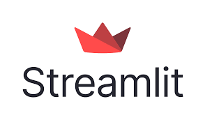

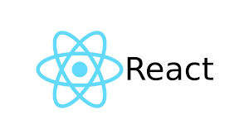


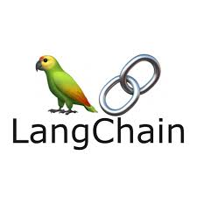

Create a quick turn around project
Project can be built using multiple options which will help us to understand Gen AI capability and shortcomings
Step - 1
Step - 2
Step - 3
Step - 4
Step - 5
Requirements Gathering
Select appropriate methodology
Develop the concept
Testing & Validation
Documentation & Deployment
Full Stack
Application
Toy Demo Application
Cloud Based Application
OR

Slide 19
Appendix

Slide 20
1. CX – LLM Chatbot (Customer Experience with LLM) for an Airline
CX-LLM is an advanced GenAI chatbot tailored for seamless ticket booking and social media integration, revolutionizing user interactions in the realm of customer service.
Scope
Granularity
Model Refresh Cycle
Key Output
CX-LLM is a natural language-based chatbot designed for ticket booking and social media integration, enhancing user interactions and streamlining the booking process
CX-LLM addresses user inquiries and booking activities with a focus on general questions and ticket booking tasks, providing a comprehensive solution for user engagement
The chatbot's model undergoes periodic updates to incorporate improvements and adapt to evolving user needs and preferences
CX-LLM delivers prompt responses to user queries, facilitates ticket bookings seamlessly, and integrates with social media platforms for enhanced accessibility and convenience
Transform
CX-LLM employs advanced LLM processing techniques, powered by models like OpenAI's LLM, to understand user queries, generate responses, and facilitate ticket bookings with efficiency and accuracy.
Input Data
Modelling
The chatbot utilizes various sources of data, including user inputs, social media interactions, and backend systems such as Navitaire (airline management system) API, to generate accurate responses and facilitate bookings.
Data preprocessing and transformation techniques are applied to input data to ensure compatibility with the chatbot's natural language understanding and response generation capabilities.

Slide 21
2. HR – LLM query management bot
HR-GPT is a Generative AI-based chatbot that answers user queries in natural language regarding HR-related issues.
Scope
Granularity
Model Refresh Cycle
Key Output
Development of HR-GPT, a Generative AI-based chatbot for HR-related queries, utilized policy documents for accurate responses, aimed at reducing human interaction and workload.
HR-GPT addressed individual queries from employees regarding HR policies, provided instant responses in natural language.
The model was periodically updated to incorporate any changes or additions to the HR policies.
Instantaneous responses to employee queries regarding HR policies, enhanced efficiency, and reduced response time.
Transform
Large language models and AI algorithms were utilized to develop the HR-GPT chatbot capable of understanding and responding to natural language queries regarding HR policies.
Input Data
Modelling
Policy documents related to HR policies of the airline company served as the foundation for generating responses.
HR related PDF text is extracted and split into different chunks,
These chunks are converted into vector embedding and store in vector database.
User query also converted in vector embedding that is asked from chatbot interface.
Semantic search is done between vector embeddings of user query and pdf text content.
02

Slide 22
3. Knowledge Management - Conversational AI for business insights
TransOrg has pioneered a Conversational AI solution tailored for extracting business insights which is proficient in interpreting natural language queries, it navigates through extensive and intricate SQL databases to provide users with comprehensive responses.
Scope
Granularity
Models Utilized
Key Output
The Conversational AI system offers versatile capabilities, allowing it to handle various tasks such as managing Q&A and summarization tasks utilizing the provided data source
Customer level insights
Sales executive/corporate level insights
Predictive future action
Cross-sell/up-sell recommendations
Real Time Dashboards
OpenAI GPT-3.5 turbo 4k model. (Best Performer)
Open-Source LLM such as Neural Chat 7B, Dolphin 7B, Deep seek 7B and SQL coder 7B.
Responding to user queries in natural language.
Providing responses in visual formats
Retrieving accurate data from the provided data source.
Input Data
Transform
Modelling
Seamlessly integrate with a diverse array of input sources, including MySQL and SQLite databases, SSMS, PostgreSQL, Oracle, Microsoft Access databases, Amazon RDS, Google Cloud SQL, along with multimedia files like text, audio files, etc.,
User queries are analysed and converted into machine query using Lang Chain Agents
The data extracted from the source get transformed into insights in natural language using LLM.
The retrieved data undergoes additional processing to refine the results or incorporate complex logic and visualize them in real-time on screen
Models are implemented in Lang Chain using two different methodology :
Lang Chain Chains
Lang Chain Agents
SQL data source Agents :
SQL Database chains
Create SQL Agent
Audio/Text File :
Google Recognizer
02

Slide 23
4. Call Assistance Bot
A Generative AI-based solution that answers user queries in natural language regarding two-way call conversation.
Scope
Granularity
Model Refresh Cycle
Key Output
The developed Chatbot can be implement for various task such as handling Q&A, Summarisation task and Sentiment Analysis.
We can ingest multiple PDF of varying complexities such as call transcript documents of different languages.
Google recognizer model used for generating calls transcript and need to run for every new call.
Every time when we make connection using OpenAI API key Chatbot model will refresh itself.
Speech to text solution provides English and Hinglish call conversation transcript in form of PDF.
Chatbot provide relevant response as per user query using LLM.
1
2
3
4
Input Data
Transform
Modelling
Recorded call audios in WAV format.
Call conversation transcripts in form of PDF.
Multiple PDF can be ingested at same time and PDF of call transcript can be of different language such as English, Hinglish and Hindi.
First PDF text is extracted and split into different chunks,
These chunks are converted into vector embedding and store in vector database.
User query also converted in vector embedding that is asked from chatbot interface.
Semantic search is done between vector embeddings of user query and pdf text content.
Resultant of semantic search leads top k chunks relevant to user query.
After that Prompt + user query + top k chunks passed to the LLM (GPT 3.5 turbo).
At the end LLM reorganised and structured the chunks as per user query and provide the response on the chatbot interface.
02

Slide 24






Email info@transorg.com or visit www.transorg.com
USA
India
Bobby Chetal
Bobby.chetal@transorg.com
Raajeev Aggarwal
raajeev.aggarwal@transorg.com
Rohit Valia
rohit.valia@transorg.com
John Nardo
John.nardo@transorg.com
Mayank Jain
Mayank.jain@transorg.com
Shuchita Jain
shuchita.jain@transorg.com
M: +91 98112 60911
Gaurav Koriya
Gaurav.koriya@transorg.com
M: +91 84475 75210
Sonakshi Das
sonakshi.das@transorg.com
M: +91 99582 75650
Singapore
Vikas Mohan
M: +65 9831 1546
LinkedIn
Facebook
X
YouTube

